Slide 1
Detection of fire combustion in forest using IBM watson studio

Slide 2
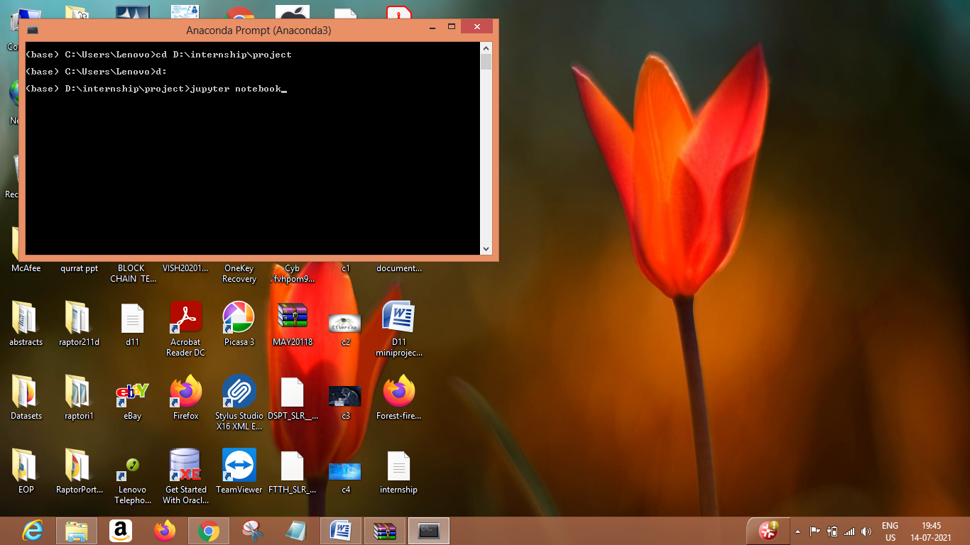
Open anaconda prompt and open jupyter notebook

Slide 3
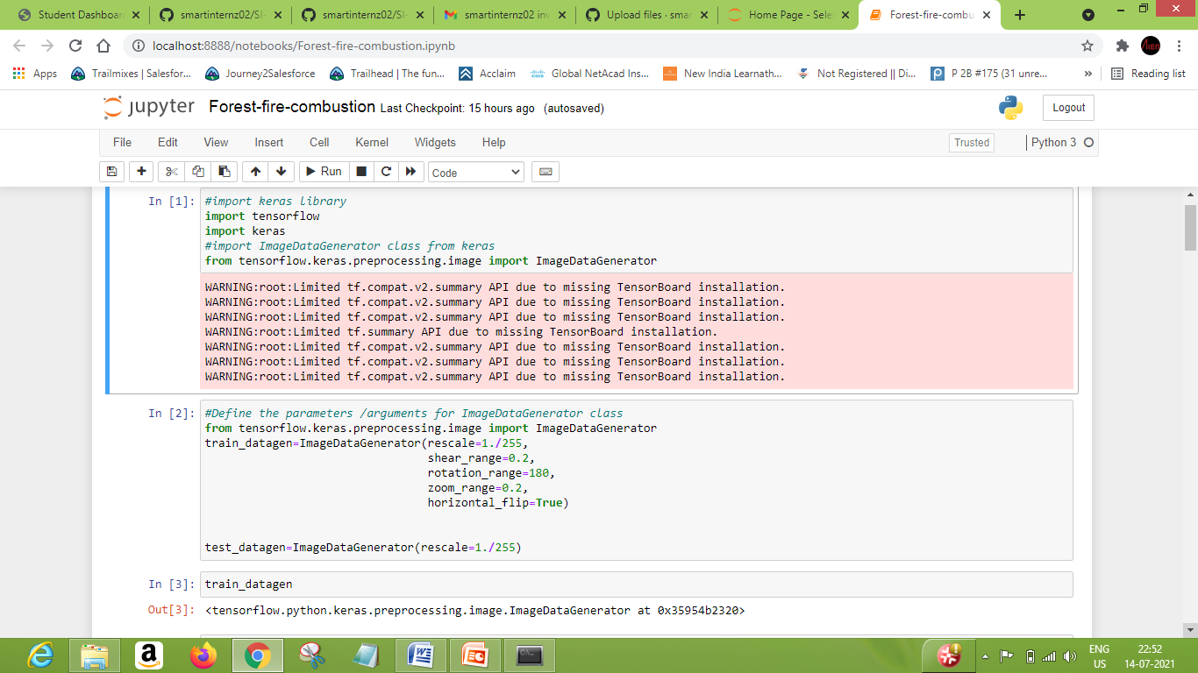
Now import necessary libraries and add functionality to trainset and testset

Slide 4
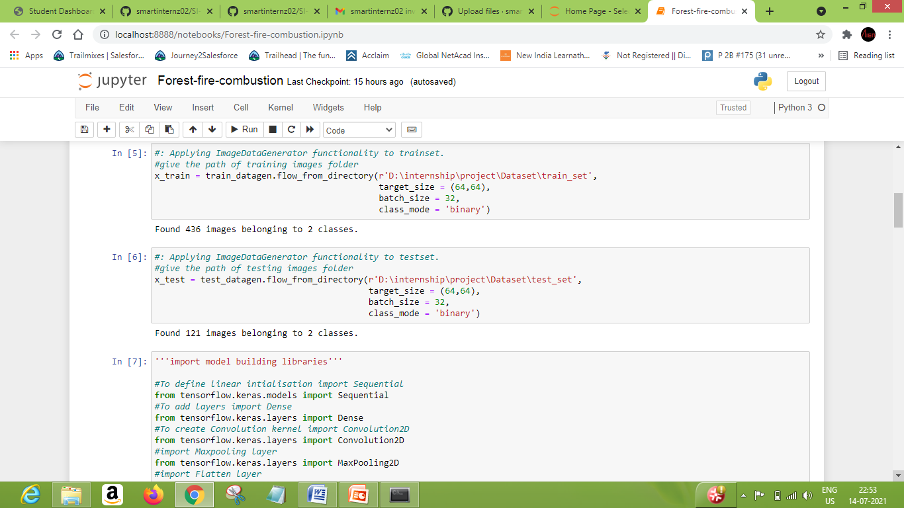

Slide 5
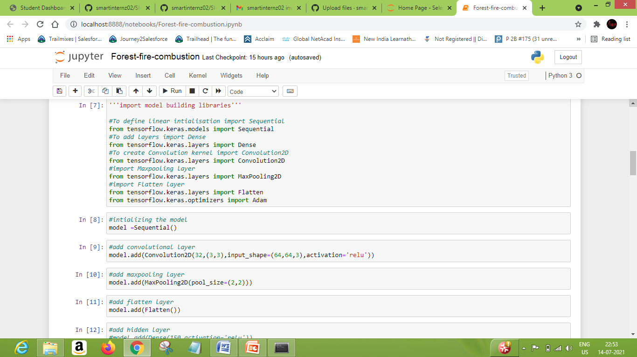
Import model building libraries

Slide 6
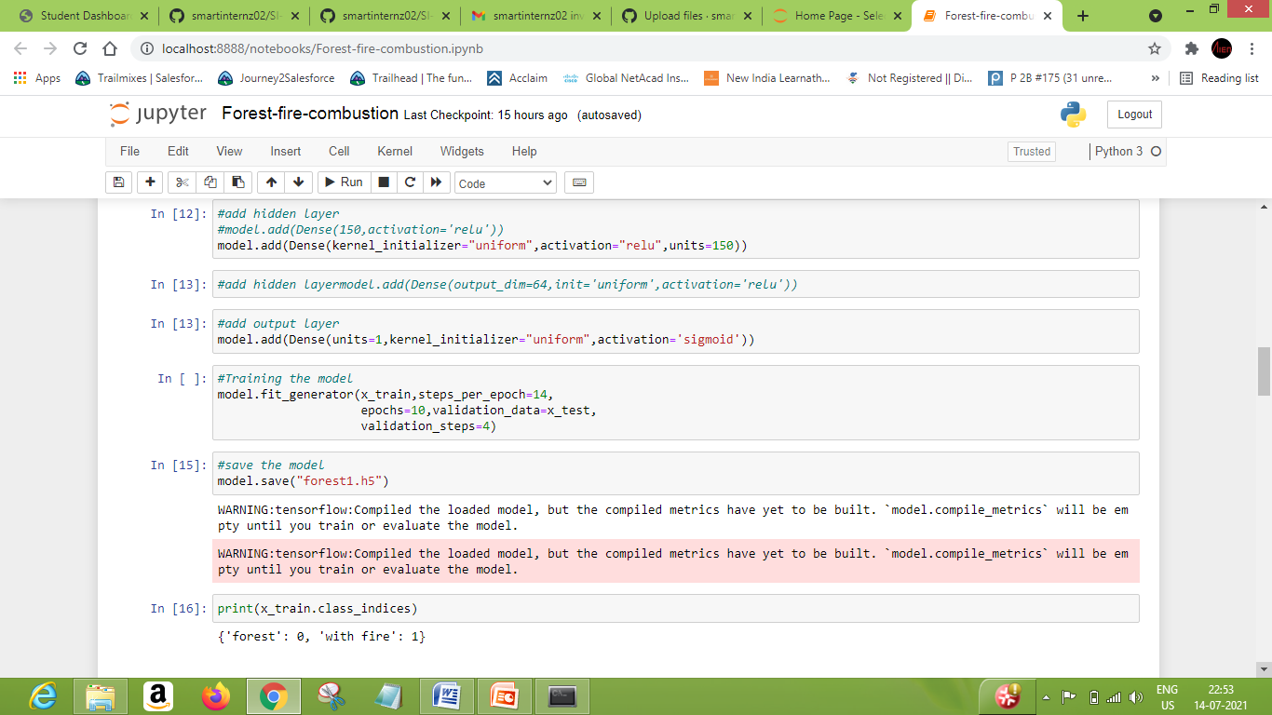

Slide 7
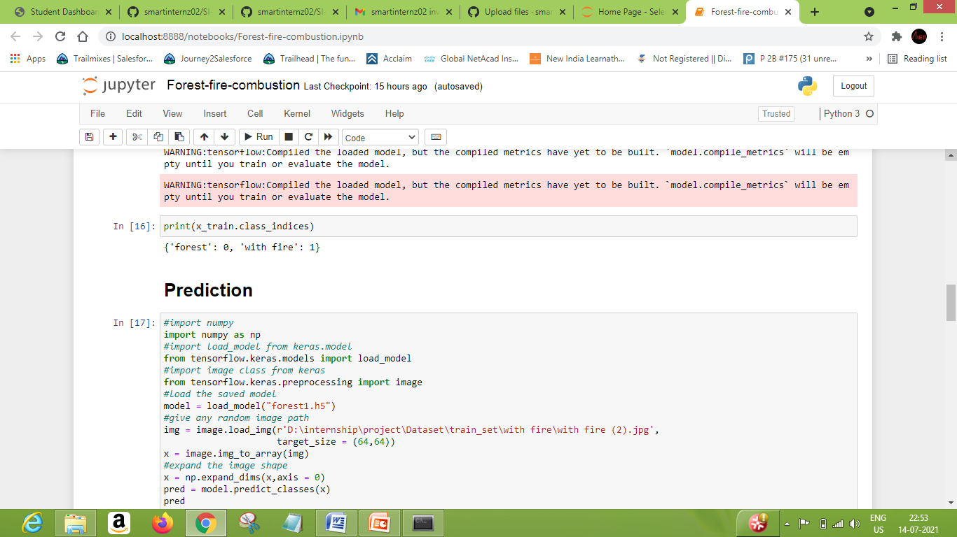
Now perform opencv prediction

Slide 8
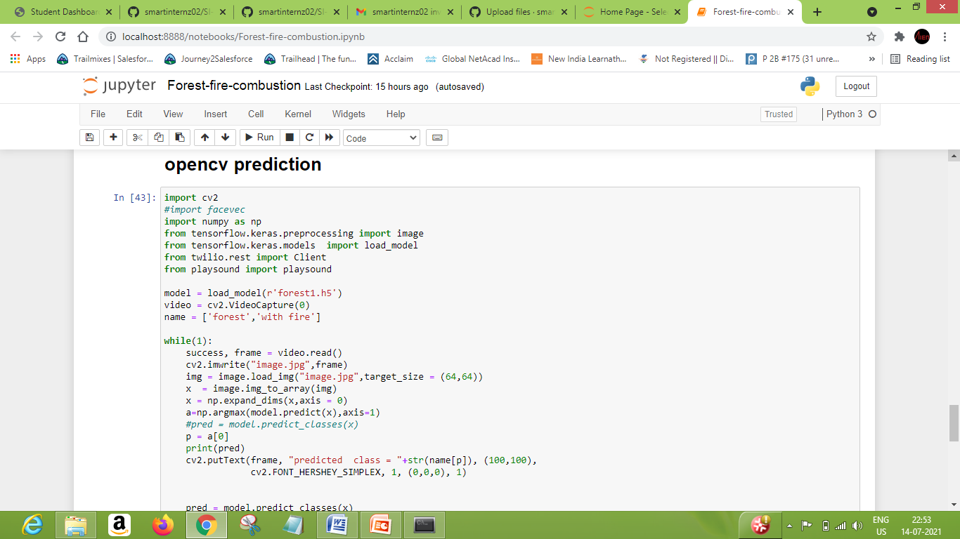

Slide 9
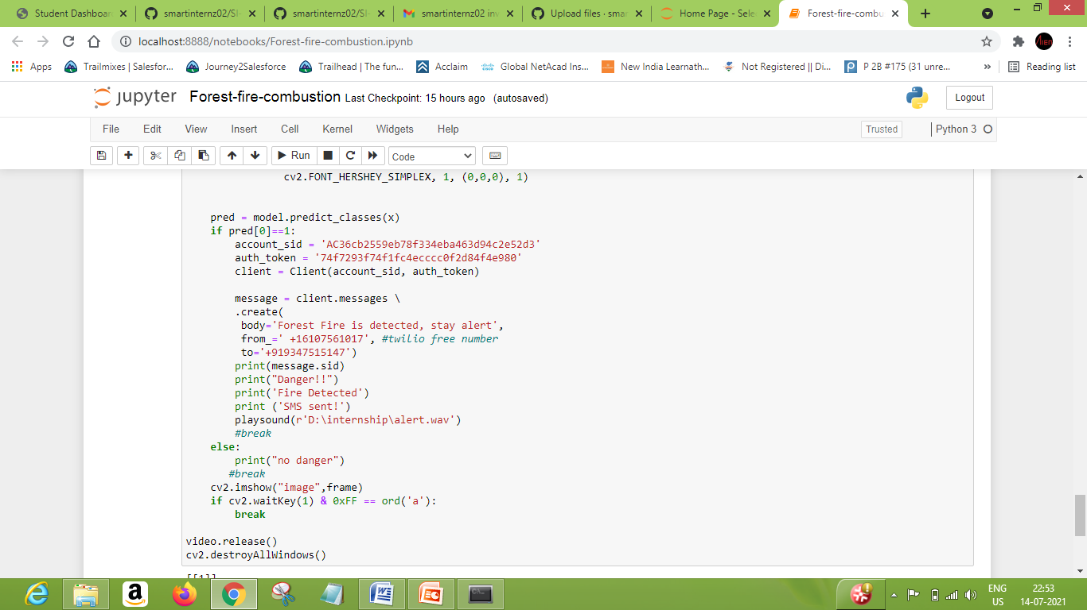

Slide 10
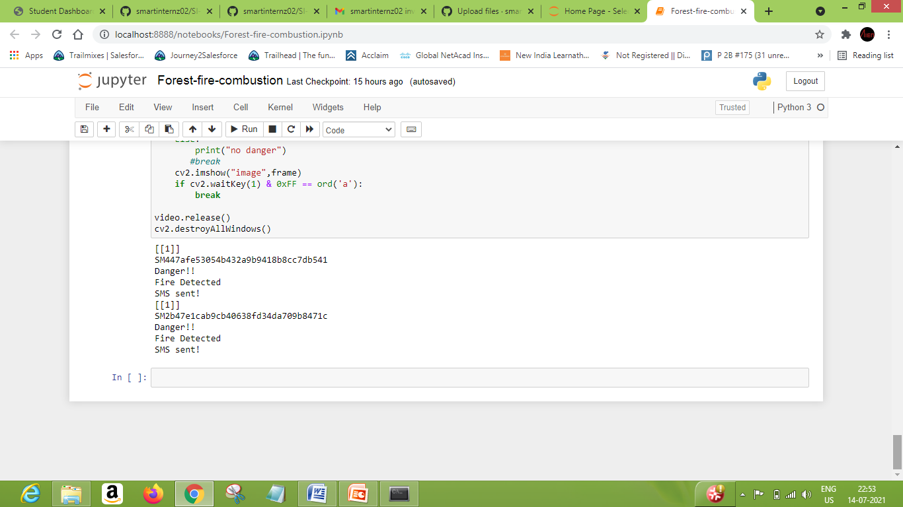
Now it gives alert message

Slide 11
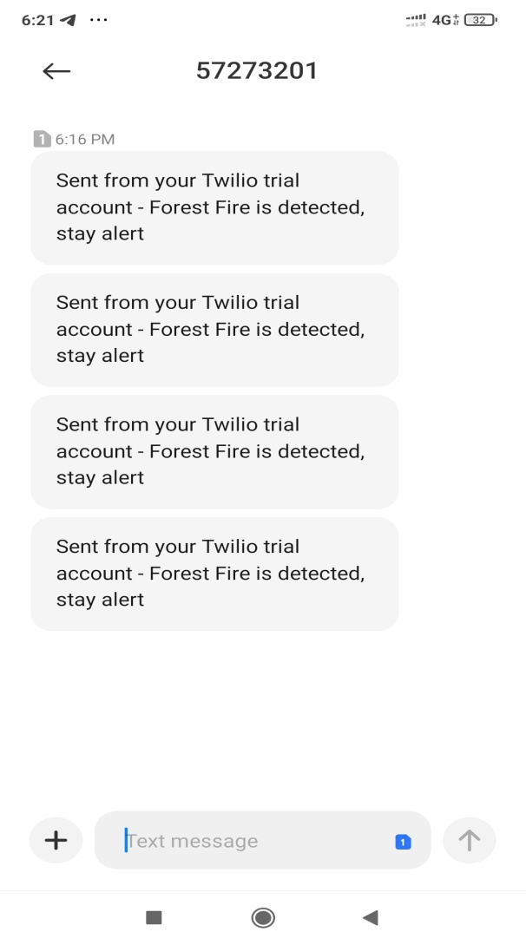
Message will be send to mobile from twilio service.

